Slide 1
A Study of Political Commentaries Online A Natural Language Processing Experiment
Mark Gallo

Slide 2
Key Research Question
Can political division be revealed through the creating and leveraging of a corpus of words derived from commentary online and political speaches?

Slide 3
Data
200,000 YouTube Comments
MSNBC & Fox News
113 Videos
January 3, 2020
Pre-Covid19
Top 10 influential users by reply generation ability

Slide 4
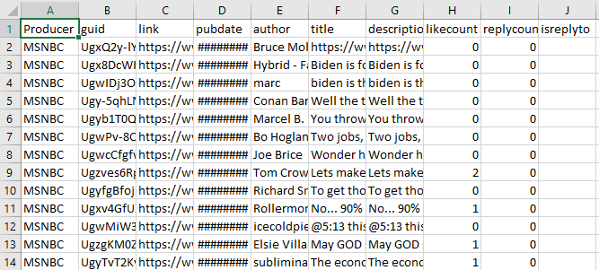
The Data Set

Slide 5
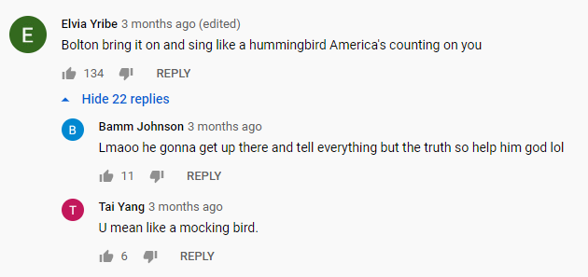
The Data of Interest
Those who exhibit influence online

Slide 6
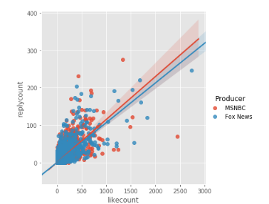
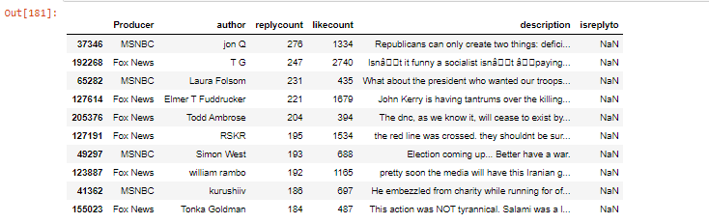
Those Who Have Influence

Slide 7
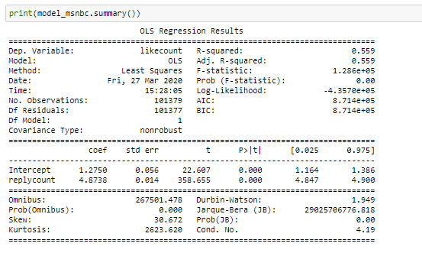
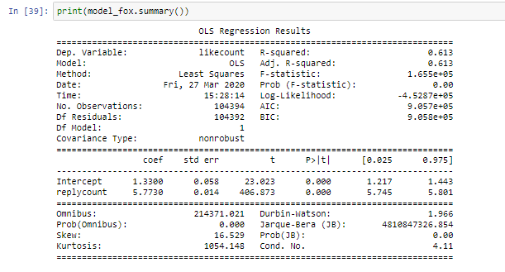
Statistical Findings
MSNBC
Fox News

Slide 8
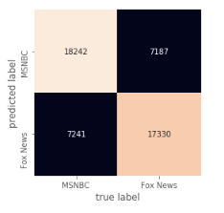
Classification – Logistic Regression
71% Accuracy

Slide 9
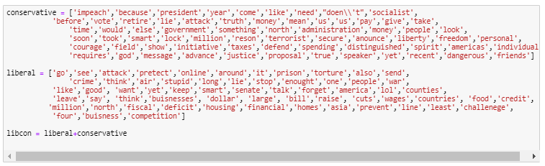
The Text Corpus : LDA + State of the Union

Slide 10
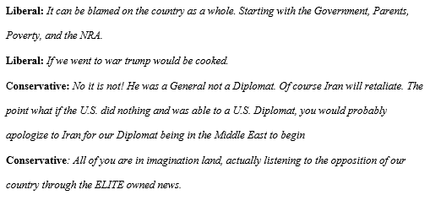
Labeling Examples

Slide 11
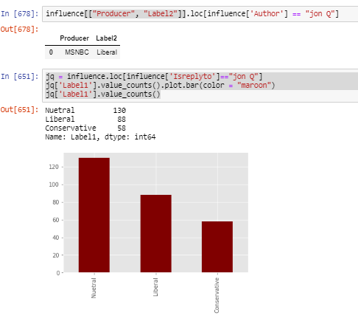
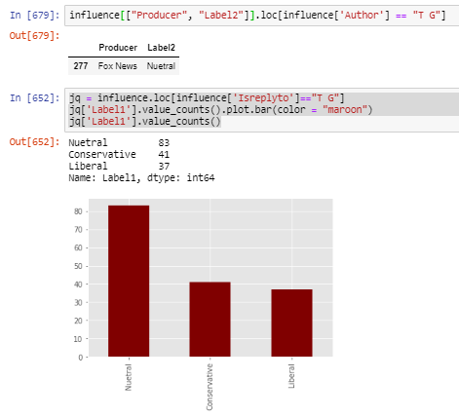
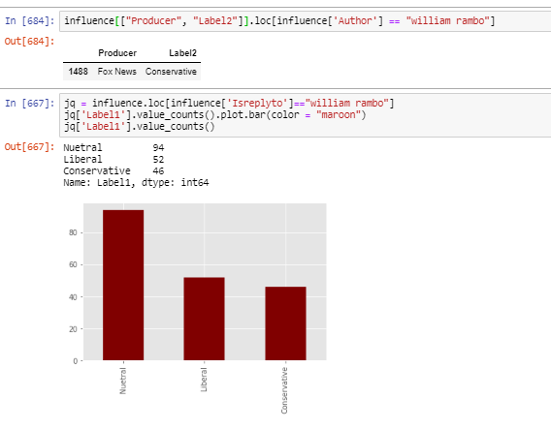
The Labeling of Those With Influence

Slide 12
Conclusions
Labeling Majority Liberal
Despite larger liberal word corpus and more Fox News comments
Labels on MSNBC strictly liberal
Labels on Fox News closer to 50/50
Of the Top 10 influencers none reported majority conservative replies
Going forward, corpus generation needs a linguistic understanding
Bots propose a threat to figures and create a margin of error
As more people communicate publically online this research becomes simpler to replicate.

